Slide 1
QUIZBOX
QUIZ MANAGEMENT SYSTEM
BY THE LAST BENCHERS…😊

Slide 2
AIM OF THE PROJECT
TO CONDUCT THE QUIZ IN A MORE EFFICIENT AND TECHNICAL APPROACH

Slide 3
LITERATURE SURVEY
THE MAIN PROBLEM WE ARE FACING IS THE COPYING ISSUE IN ALL THE SCHOOLS AND COLLEGES.
We have faced a lot of difficulties while developing this software we have used the following to rectify the errors:
StackOverflow

Slide 4
FEATURES OF THE QUIZBOX
Application does not allow you to change the window unless you complete your exam.

Slide 5
SOFTWARE REQUIREMENTS
OS CAN BE WINDOWS / LINUX / MAC.
JDK

Slide 6
SOFTWARES USED
VISUAL STUDIO CODE
ECLIPSE JAVA EE
JDK Version 12

Slide 7
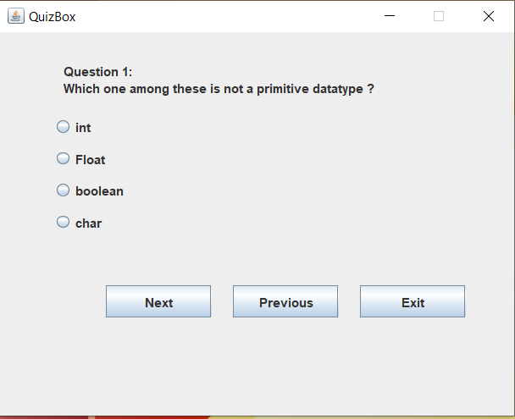
BASIC SCREENSHOT OF THE QUIZBOX

Slide 8
COMPARISON
LET’S HAVE A COMPARISION OF MOODLE WHICH CURRENTLY IN TREND
QUIZBOX
MOODLE
It’s an application which does not require any of the software except the JRE
It opens in a new window and cannot be closed until and unless the quiz completes or user exits.
In this particular Java Application we have disabled COPY and PASTE option where a user cannot enable it again.
Requires any of the web browser (ex . Chrome)
This also opens in a new browser window or tab where it can be minimized and also can copy from internet.
But where as in this the COPY and PASTE can be done by using disabling the JAVASCRIPT from the Developer Tools of any web-browser .

Slide 9
FURTHER UPDATES FOR QUIZBOX
We would filter the IP Address location and the User Account so that each user can access the account only once during the exam
We would create a simple user interface for the faculty and the administration so that the Questions can be added manually

Slide 10
THANK YOU!
THE LAST BENCHER’S
SAI CHINMAY.T – 180330100 (Frontend)
SUMANTH.B – 180330007 (Logic)
SAI HRUTHIK.B – 180330010 (Backend)
PRAMOD.K – 180330030 (Testing)

